Slide 1
MATLAB (Huang Lab) vs. Python (Chi3) Simulations
5 m, DC 6/125 YDF gain fiber w/ 9.6e25 doping concentration
300 fs, 1.75 nJ Gaussian pulse @ 10 MHz

Slide 2
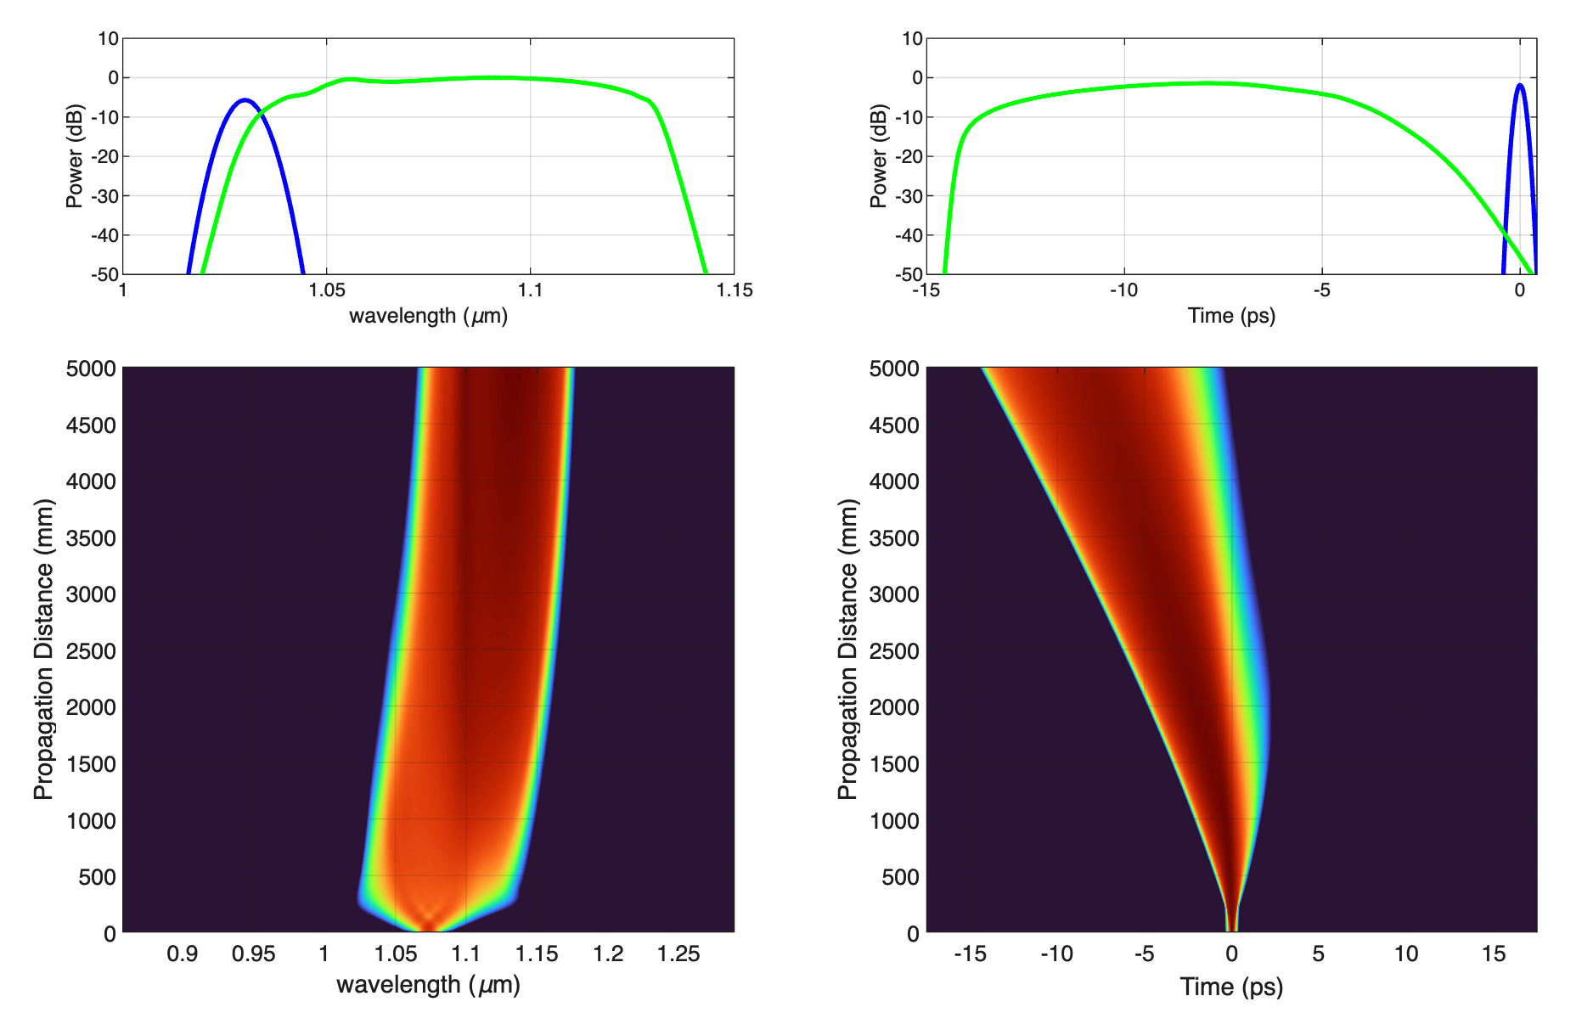
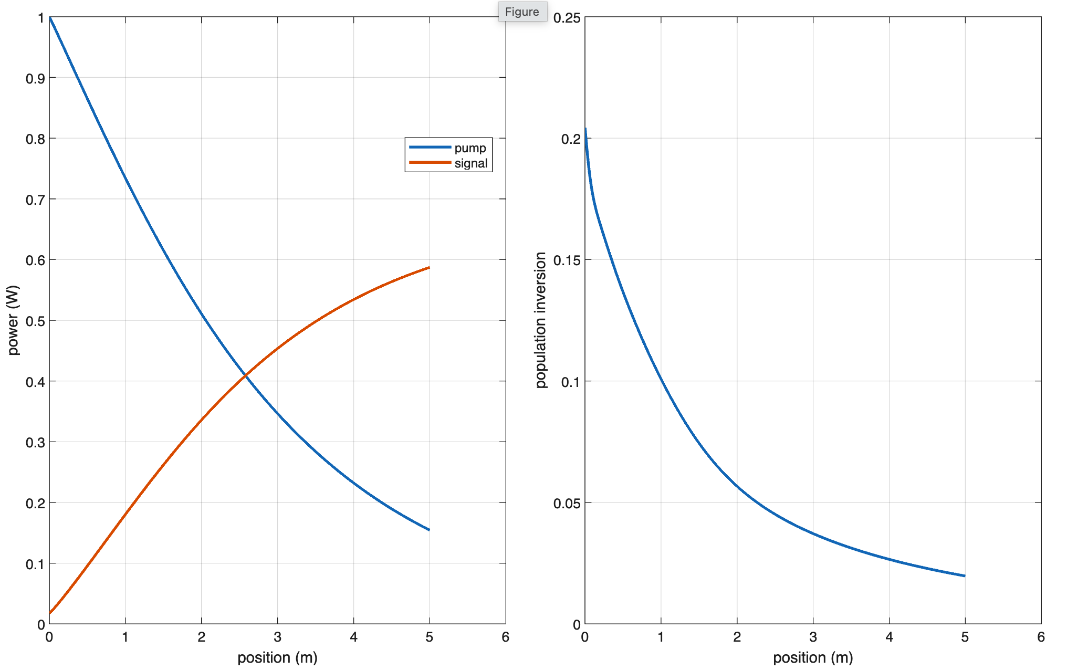
MATLAB

Slide 3
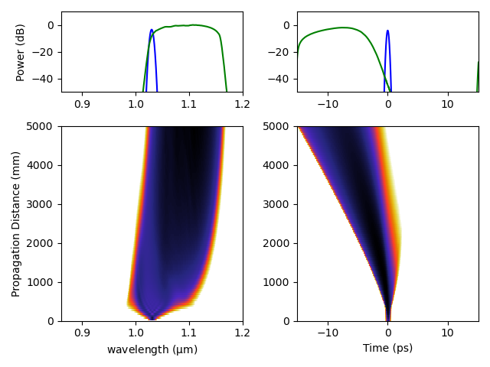
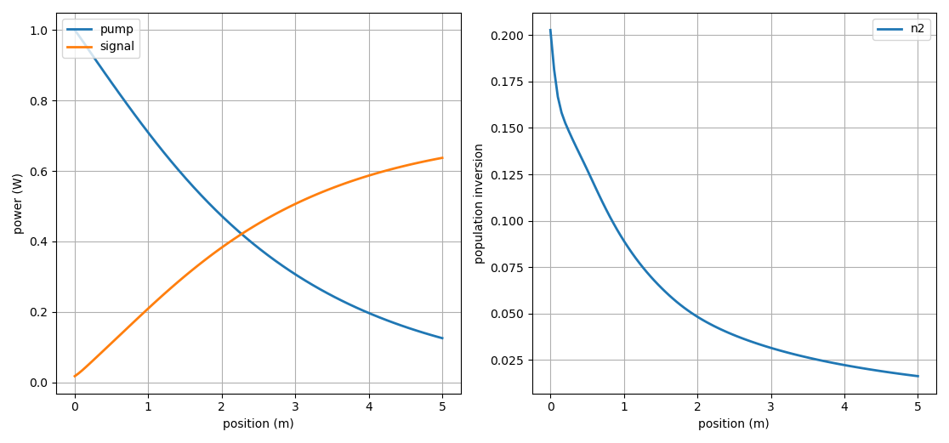
Python

Slide 4
MATLAB (Huang Lab) vs. Python (Chi3) Simulations
1 m, DC 6/125 YDF gain fiber w/ 9.6e25 doping concentration
300 fs, 1.75 nJ Gaussian pulse @ 10 MHz

Slide 5
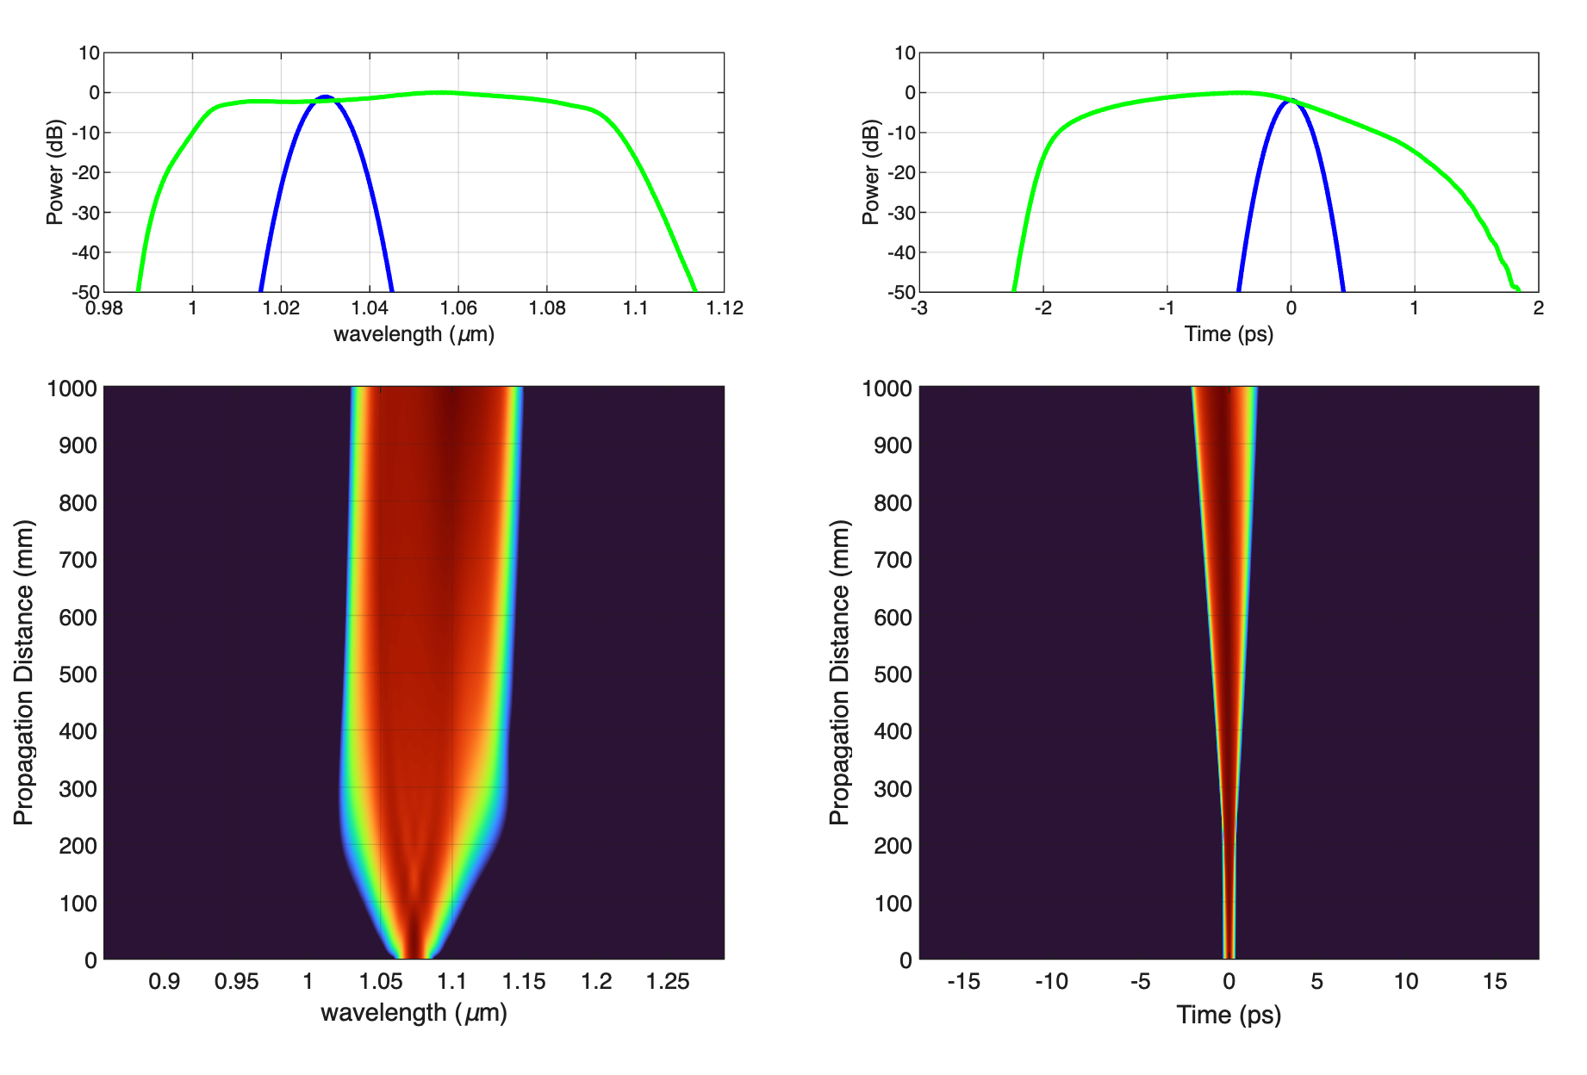
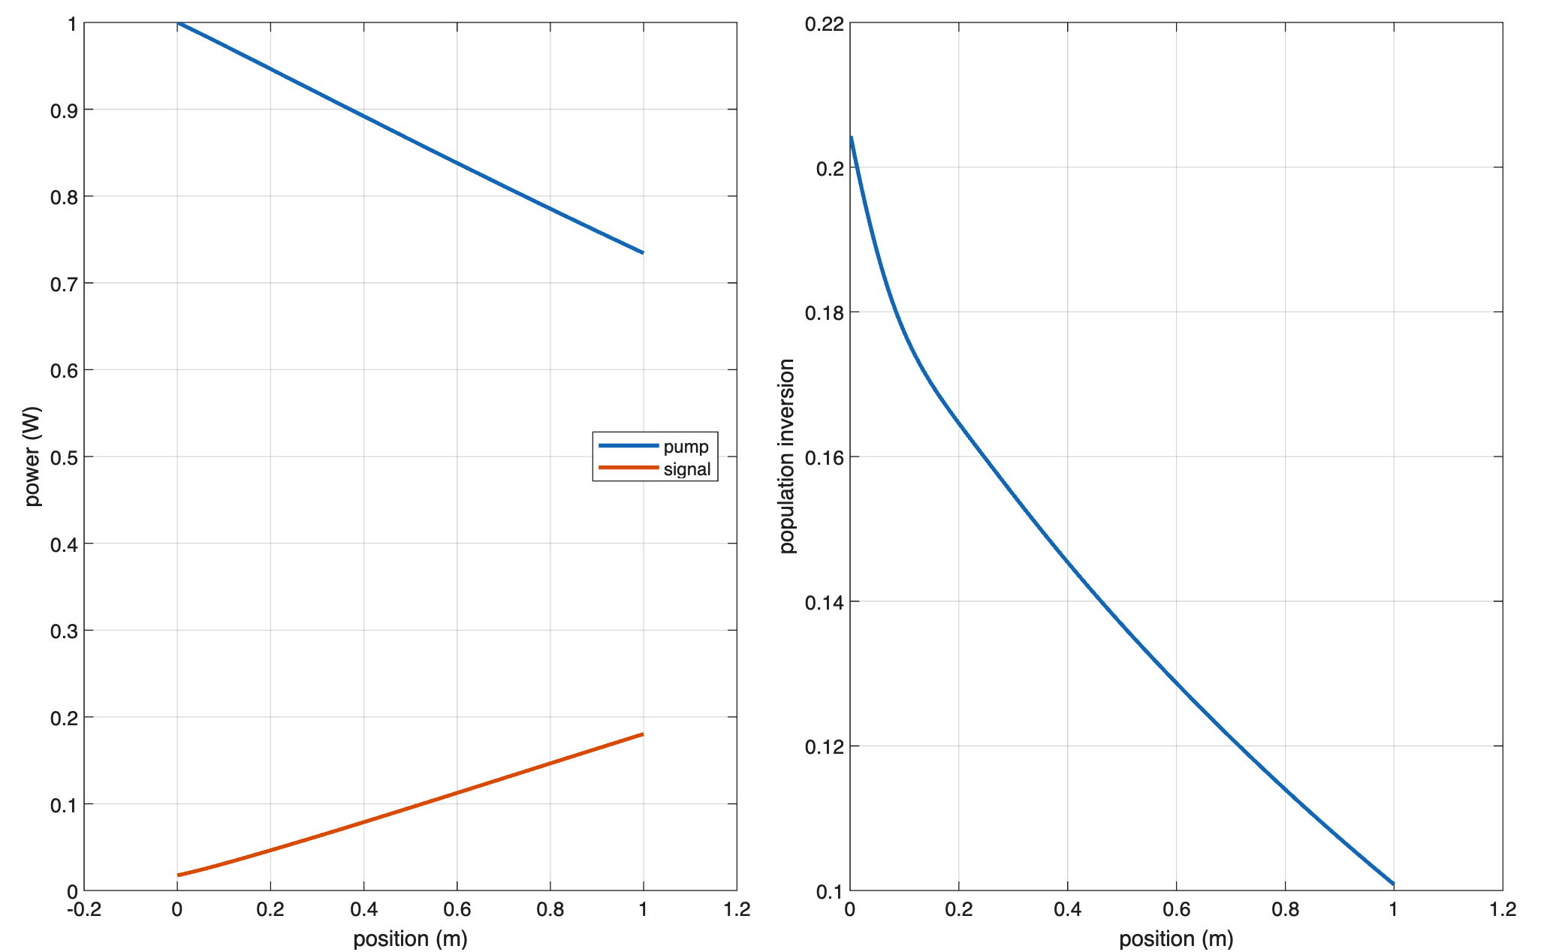
MATLAB

Slide 6
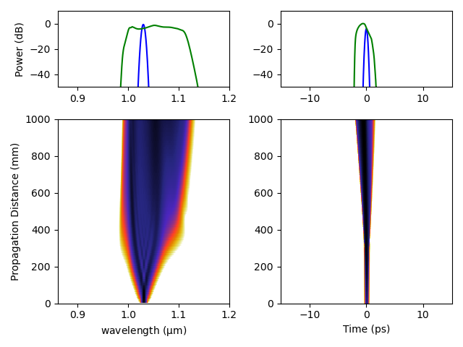
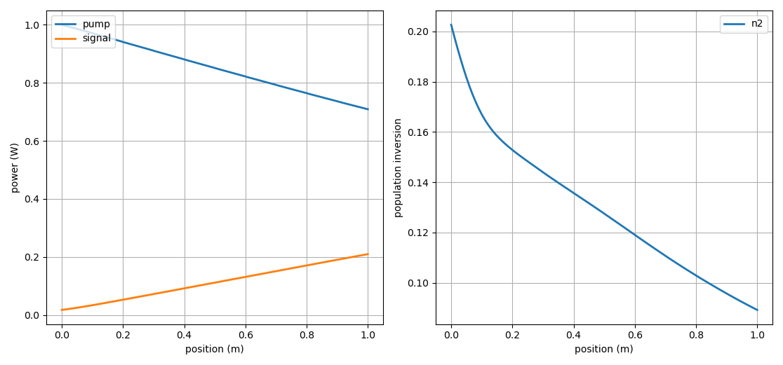
Python

